Slide 1

MUSIC STORE DATA ANALYSIS USING SQL
Presented by:
M. Amrutha Ravali

Slide 2

Introduction
The digital music market produces an immense stream
of customer interactions and sales records. Unlocking
the value of this information requires careful analysis
to reveal listening habits, trending genres, leading artists,
and revenue drivers.
This project focuses on exploring a music store database
that captures details about customers, tracks, albums,
artists, and purchase activity. By leveraging SQL queries,
the raw data is transformed into clear insights—
highlighting preferences, identifying profitable segments,
and uncovering regional differences.
The ultimate aim is to turn complex datasets into practical
knowledge that supports smarter, evidence-based
decisions in the music business.

Slide 3

Problem Statement
Music retailers gather large volumes of transactional and customer data, but often struggle to translate it into meaningful business intelligence. By applying SQL-based analysis, this raw information can be transformed into clear insights that guide strategic decisions. Key questions to explore include:
Customer value: Which buyers contribute the most to overall sales?
Regional performance: What geographic areas drive the highest revenue?
Product trends: Which music genres and artists are consistently in demand?
Market differences: How do purchasing habits vary across different countries?
The objective is to move beyond data collection and uncover actionable patterns that highlight customer behavior, regional strengths, and product popularity—ultimately enabling smarter decisions and stronger growth.

Slide 4
Objectives
The objective of this project is to analyze a music store data using SQL to extract meaningful business insights.
The key objectives of this project is:
Understand relational database structure.
Apply SQL concepts to get the meaningful insights from the data.
Practice complex SQL queries.
Analyze the customer behaviour and sales pattern.
Identify top customers, popular genres, popular cities and revenue sources.
Support data-driven business decisions.
This project applies SQL concepts to a real-world dataset to simulate business analytics scenarios

Slide 5
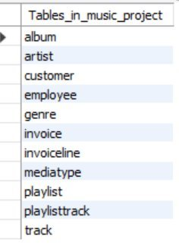
Tables

Slide 6


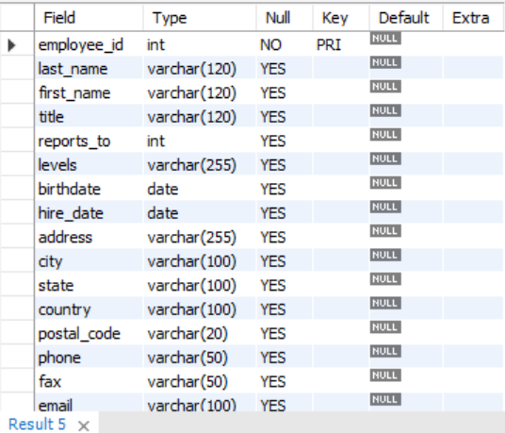
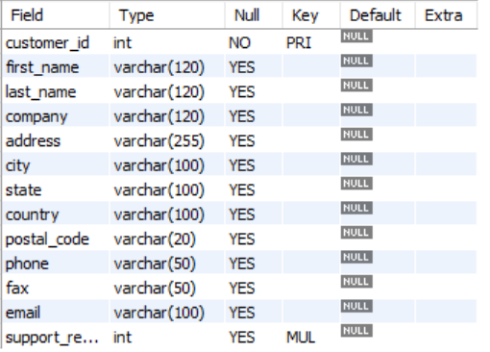
1. Genre Table
Tables Structures
2. MediaType Table
3. Employee Table
4. Customer Table

Slide 7

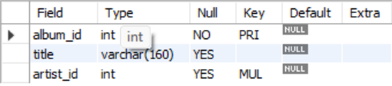
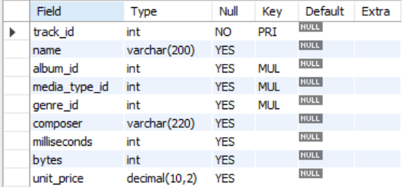
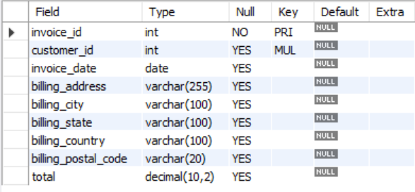
6. Album Table
5. Artist Table
7. Track Table
8. Invoice Table

Slide 8
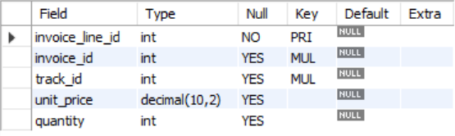


11. Playlisttrack Table
9. Invoiceline Table
10. Playlist Table

Slide 9
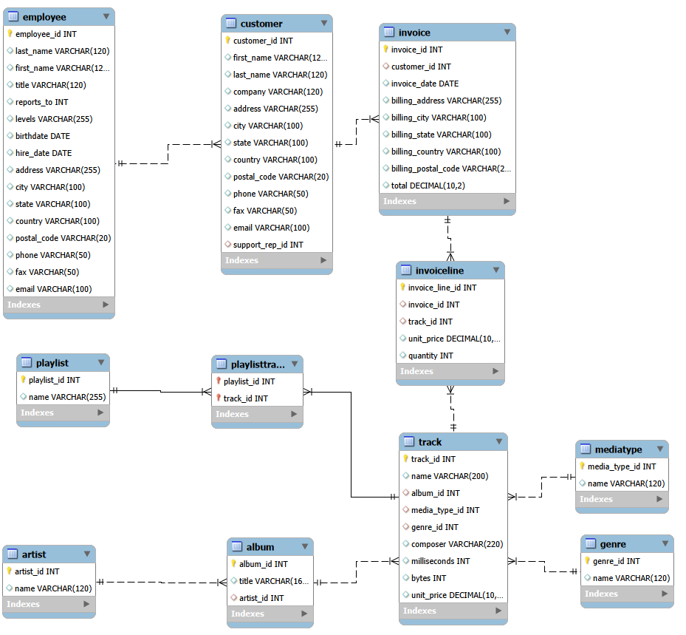
ER Diagram

Slide 10
Analysis
Who is the senior most employee based on job title?
Which countries have the most Invoices?
What are the top 3 values of total invoice?
Which city has the best customers? - We would like to throw a promotional Music Festival in the city we made the most money. Write a query that returns one city that has the highest sum of invoice totals. Return both the city name & sum of all invoice totals
Who is the best customer? - The customer who has spent the most money will be declared the best customer. Write a query that returns the person who has spent the most money
Write a query to return the email, first name, last name, & Genre of all Rock Music listeners. Return your list ordered alphabetically by email starting with A
Let's invite the artists who have written the most rock music in our dataset. Write a query that returns the Artist name and total track count of the top 10 rock bands
Return all the track names that have a song length longer than the average song length.- Return the Name and Milliseconds for each track. Order by the song length, with the longest songs listed first
Find how much amount is spent by each customer on artists? Write a query to return customer name, artist name and total spent
We want to find out the most popular music Genre for each country. We determine the most popular genre as the genre with the highest amount of purchases. Write a query that returns each country along with the top Genre. For countries where the maximum number of purchases is shared, return all Genres
Write a query that determines the customer that has spent the most on music for each country. Write a query that returns the country along with the top customer and how much they spent. For countries where the top amount spent is shared, provide all customers who spent this amount

Slide 11


1. Who is the senior most employee based on job title? (Senior Most Employee → Madhan Mohan [S.G.M])
Insight: The analysis shows that Madhan Mohan holds the highest position (Senior General Manager), making him the most senior employee in the organization.

Slide 12
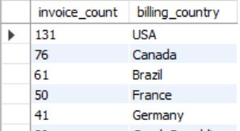

2. Which country have the most invoices? (Country with most invoice → USA 131)
Insight: The USA, Canada, and Brazil generate the highest number of invoices, indicating these countries contribute the most sales transactions.

Slide 13

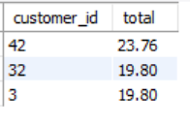
3. What are the top 3 values of total invoices? (Top 3 invoice totals)
Insight: The highest invoice value is 23.76 (Customer ID 42), followed by 19.80 from Customer IDs 32 and 3, indicating the top invoice transactions in the dataset.

Slide 14
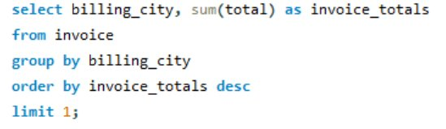

4. Which city has the highest sum of invoice totals. Return both the city name & sum of all invoice totals? (City with highest invoice totals → Prague )
Insight: Prague generates the highest total invoice revenue (273.24), making it the top-performing city in sales.

Slide 15
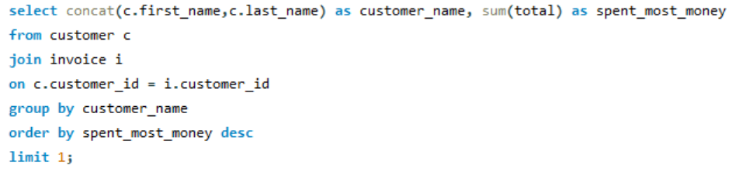

5. Who is the best customer? Write a query that returns the person who has spent the most money? (Best Customer = Highest Spending → FrantiAiek WichterovAi)
Insight: František Wichterlová is the best customer, having spent the highest total amount of 144.54 in the store.

Slide 16
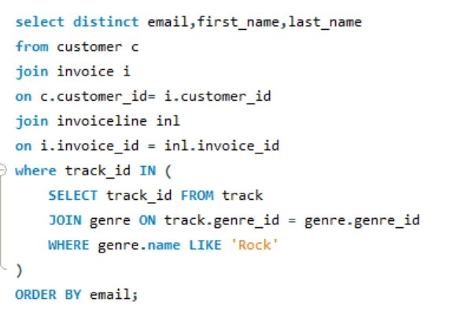
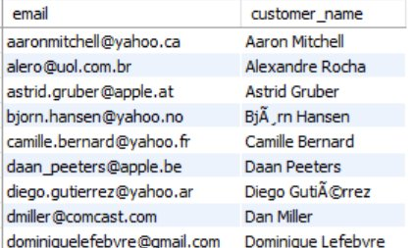
6. Write a query to return the email, first name, last name, & Genre of all Rock Music listeners in alphabetical order? (Rock genre music listeners)
Insight: The analysis identifies customers who listen to Rock music, helping the store understand genre preferences and target Rock music fans effectively.

Slide 17
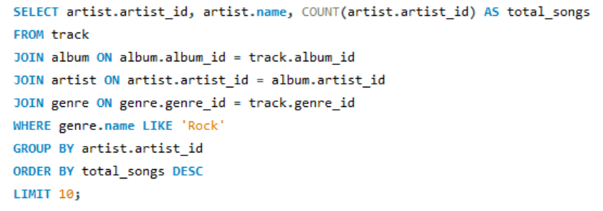
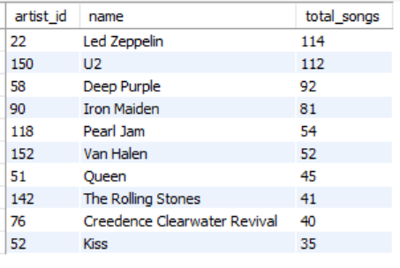
7. Write a query that returns the Artist name and total track count of the top 10 rock bands ? (Top 10 Rock genre artists)
Insight: The analysis identifies the top 10 Rock artists based on the number of tracks, with Led Zeppelin having the highest track count.

Slide 18
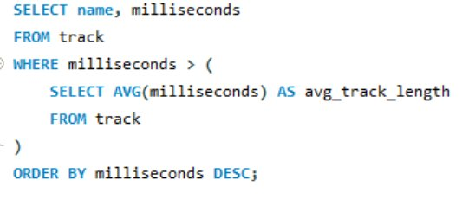
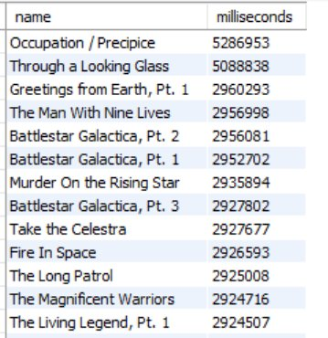
8. Return all the track names that have a song length longer than the average song length.- Return the Name and Milliseconds for each track. Order by the song length, with the longest songs listed first? (Tracks longer than average song length)
Insight: The query identifies tracks that are longer than the average song length, high lighting the longest songs in the music store database.

Slide 19
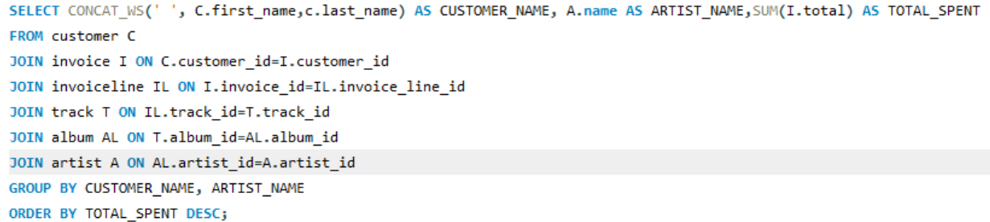
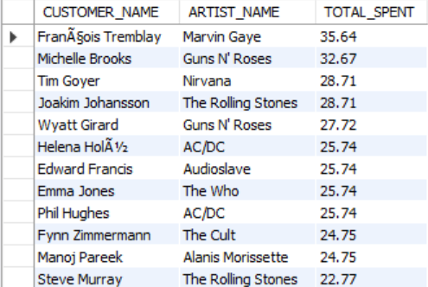
9. Find how much amount is spent by each customer on artists? Write a query to return customer name, artist name and total spent? (Customer spending on artist)
Insight: This analysis shows how much each customer spends on different artists, helping identify popular artists and customer purchasing patterns.

Slide 20
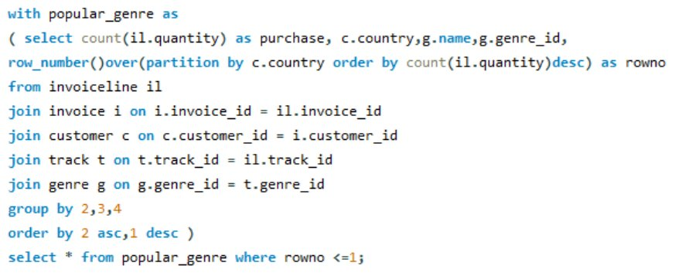
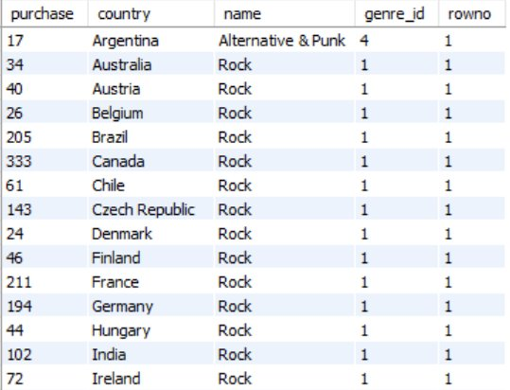
10. Write a query that returns each country along with the top Genre. For countries where the maximum number of purchases is shared, return all Genres? (Most popular genre by country)
Insight: The analysis identifies the most popular music genre in each country based on the highest number of purchases.

Slide 21
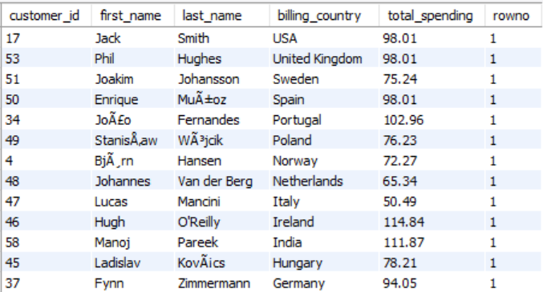
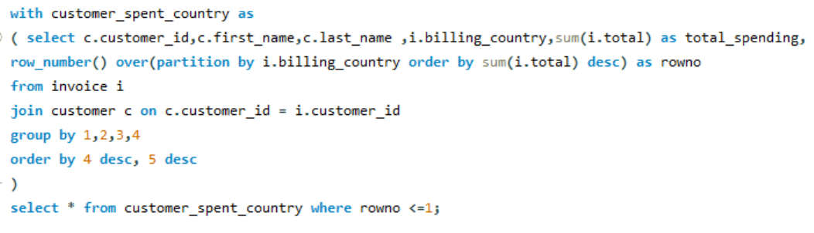
11. Write a query that returns the country along with the top customer and how much they spent. For countries where the top amount spent is shared, provide all customers who spent this amount? (Top customer per country)
Insight: The analysis identifies the top-spending customer in each country, helping understand customer value across different regions.

Slide 22
Key Insights
Revenue shows strong concentration in particular cities and countries.
A small group of customers accounts for the majority of sales.
Regional preferences reveal certain genres leading in specific markets.
Rock music emerges as the top-selling genre overall.
The rock category demonstrates a loyal and widespread listener base.
Purchasing behavior is heavily shaped by the popularity of leading artists.

Slide 23
Conclusion
This initiative highlights how SQL can be leveraged to convert raw transactional records into meaningful insights that drive business growth.
Through the analysis:
Patterns in customer behavior were uncovered.
Revenue performance was tracked and evaluated.
Market preferences were identified and interpreted.
Findings provided a foundation for informed strategic decision-making.

Slide 24


